Slide 1
Functions
Prof Somesh Nandi
Department of AIML
RVCE

Slide 2
What are Functions?
In c, we can divide a large program into the basic building blocks known as function.
The function contains the set of programming statements enclosed by {}.
A function can be called multiple times to provide reusability and modularity to the C program.
In other words, we can say that the collection of functions creates a program.

Slide 3
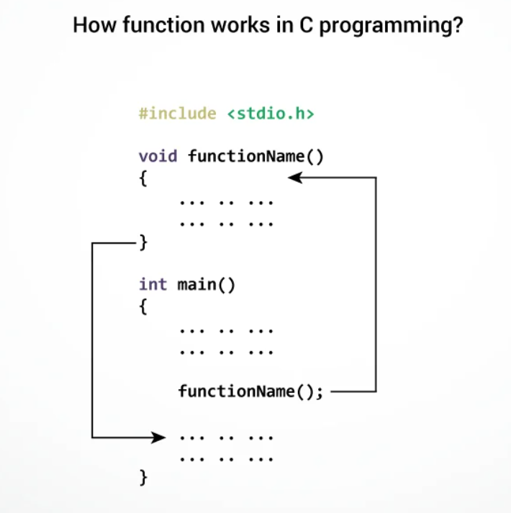
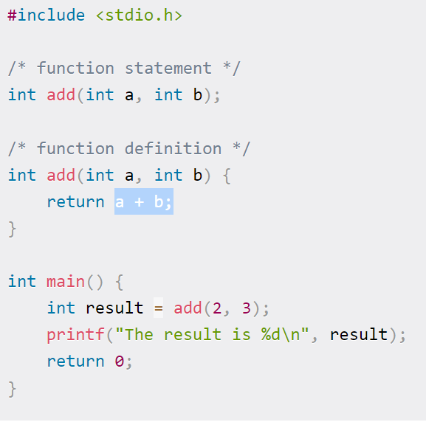

Slide 4
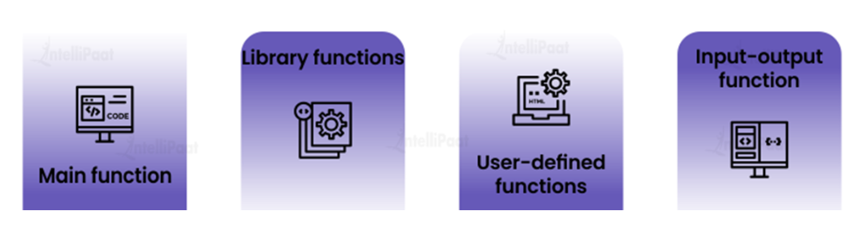
Types of Functions
Main function – This function marks the start of any C program.
Library functions – These are preset functions that are already available in the C library, printf(), scanf(), sin(), cos(), and strlen().
User-defined functions – In the C language, a user-defined function is one that is created by the programmer to perform a specific task.
Input-output function – In C programming, an input-output function is one that either takes user input or sends data to the user.

Slide 5
Why we need functions in C
Functions are used because of following reasons – a) To improve the readability of code. b) Improves the reusability of the code, same function can be used in any program rather than writing the same code from scratch. c) Debugging of the code would be easier if you use functions, as errors are easy to be traced. d) Reduces the size of the code, duplicate set of statements are replaced by function calls

Slide 6
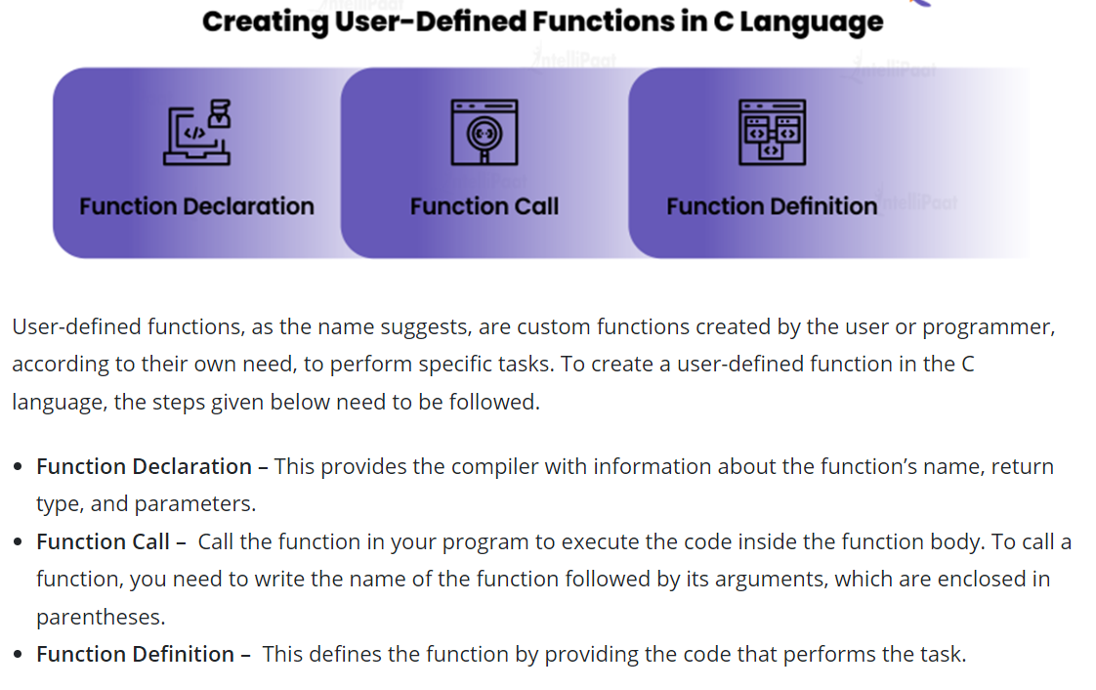
Creating the User Defined Function

Slide 7
How to Declare a Function in C
Declaring a function in C informs the compiler about the presence of a function without giving implementation details.
This enables the function to be called by other sections of the software before it is specified or implemented.
A function declaration usually contains the function name, return type, and the parameter types.
The following is the syntax for defining a function in C
return_type function_name(parameter_list);
return_type is the data type of the value that the function returns.
function_name is the name of the function, and parameter_list is the list of parameters that the function takes as input.

Slide 8
How to Declare a Function in C
We have a created function called add that takes two integers as input and returns their sum. We can declare the function as follows:
int add(int num1, int num2);
This tells the compiler that there is a function called add that takes two integers as input and returns an integer as output.
The body of the function is defined independently of the function statement, usually in a separate block of code called the function definition.

Slide 9
Example - Functions
1 2 3 4 5 6 7 8 9 10 11 12 13 14 15 16 17 18 19 20 21 | #include<stdio.h> // function prototype, also called function declaration float square ( float x ); // main function, program starts from here int main( ) { float m, n ; printf ( "\nEnter some number for finding square \n"); scanf ( "%f", &m ) ; // function call n = square ( m ) ; printf ( "\nSquare of the given number %f is %f",m,n ); } float square ( float x ) // function definition { float p ; p = x * x ; return ( p ) ; }

Slide 10
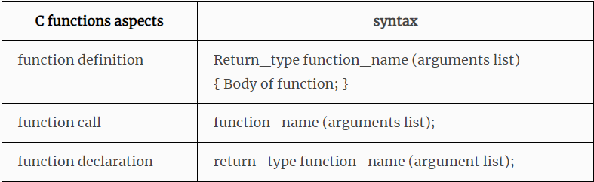
Quick Summary of Functions
There are 3 aspects in each C function. They are,
Function declaration or prototype – This informs compiler about the function name, function parameters and return value’s data type.
Function call – This calls the actual function
Function definition – This contains all the statements to be executed.

Slide 11
Using Functions and Some Important Tips
While creating a C function, you give a definition of what the function has to do - its called calling function.
To use a function, you will have to call that function to perform the defined task.
When a program calls a function, the program control is transferred to the called function.
A called function performs a defined task and when its return statement is executed or when its function-ending closing brace is reached, it returns the program control back to the main program

Slide 12
Using Functions and Some Important Tips
Using parameters while defining function is optional.
A function cant be declared inside the body of another function.
If function doesn’t specify any return type then by default integer will be defined.
Function once declared is Global it can be called at any point of the function.
void means that the function does not have a return value.

Slide 13
Return Statement in C
Return Statement is used to terminate the execution of the function.
Returns control in the point of invocation. It could also return value in that point.
Syntax
Returning control from function that does not return value: return;
Returning control from function that returns value: return <value>;
The return value could be any valid expression that returns a value:
a constant
a variable
a calculation, for instance (a + b) * c
call to another function that returns a value
The value must be of the same (or compatible) type that the function was defined. For example, an int function can’t return a float value.

Slide 14
How the return statement works?
First you need to understand how the function call works. When you call a function two things happen
The execution of the current function is paused.
The function that you call executes.
This is what we call a transfer of control. When you call a function the control of the program is transferred from the calling function to the called function. The return statement returns the control to the previous routine.
That function will continue its execution from the point where it was paused.

Slide 15
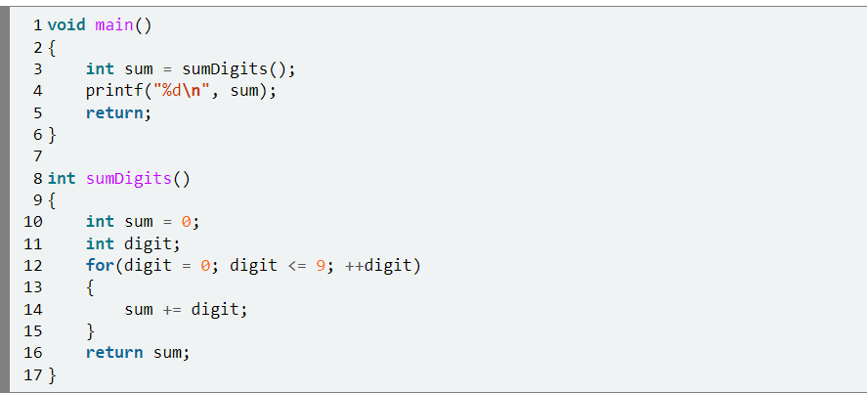
How the return statement works?
1.The function main is called when our program is started.
2.Then it calls the routine sumDigits. At this point “main” is paused and sumDigits starts.
3.The second function will do its calculations and reach the return sum; statement. Here it ends and the control is transferred back in main.
4.Since sumDigits returns a value(the value of the sum variable), a value will appear in the place where the function was called.

Slide 16
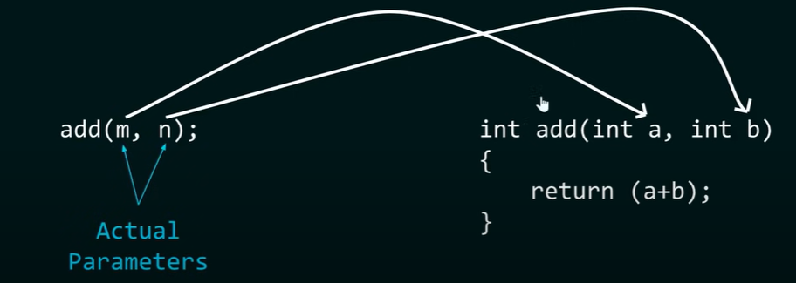
Just for Information
Actual parameter – This is the argument which is used in function call.
Formal parameter – This is the argument which is used in function definition.

Slide 17
Passing Parameters to Function
When the function is called, we need to pass the value for that function. There are two ways to pass the parameters.
1. Call by value
In call by value method, the value of the variable is passed to the function as parameter.
The value of the actual parameter can not be modified by formal parameter.
Different Memory is allocated for both actual and formal parameters. Because value of actual parameter is copied to formal parameter

Slide 18
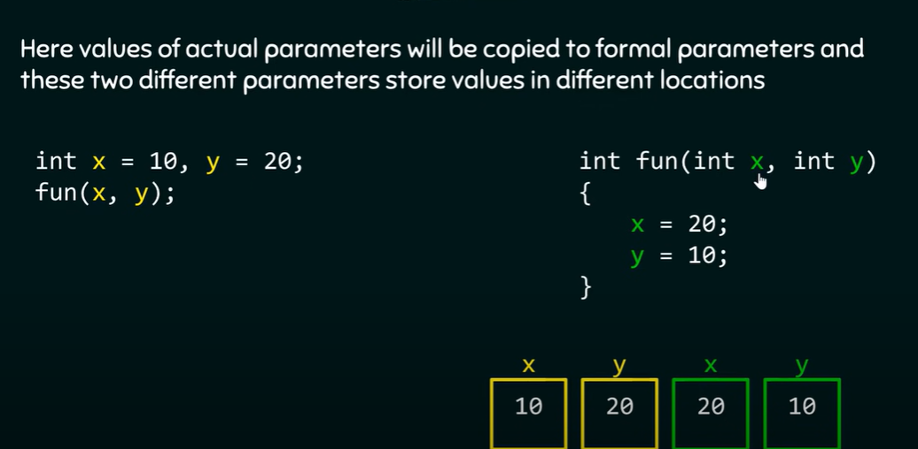
CALL BY VALUE
Actual Parameter x and y are created.
They are used in fun definition
In that the values of x and y are changed , but that will not affect the actual parameter values.

Slide 19
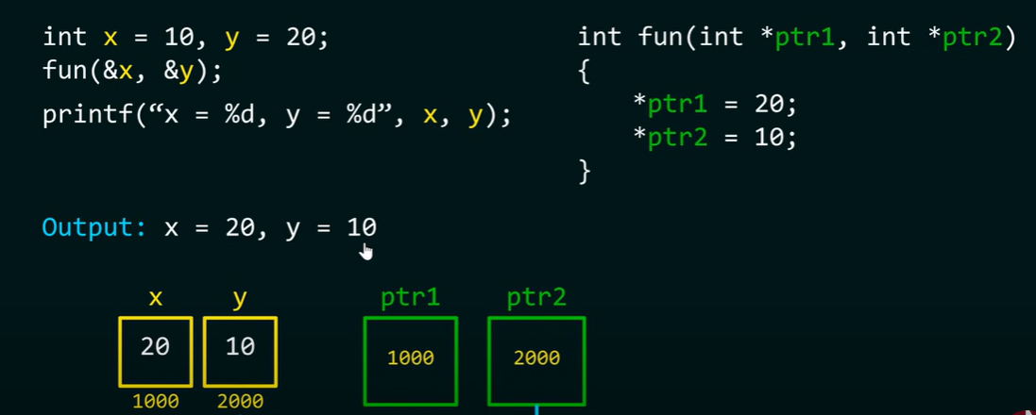
Call by Reference
In call by reference method, the address of the variable is passed to the function as parameter.
The value of the actual parameter can be modified by formal parameter.
Same memory is used for both actual and formal parameters since only address is used by both parameters.

Slide 20
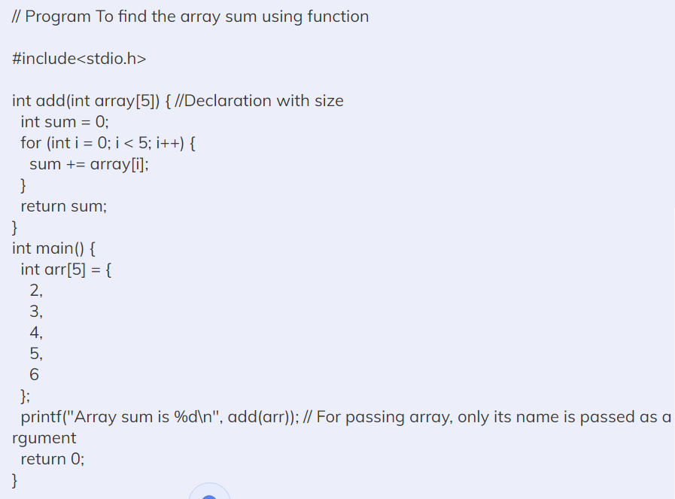
Passing Arrays to Functions
There are three ways to pass arrays to functions.
First Way – The receiving parameter of the array may itself be declared as an array, as shown below:
Syntax:-
return_type function(type arrayname[SIZE])

Slide 21
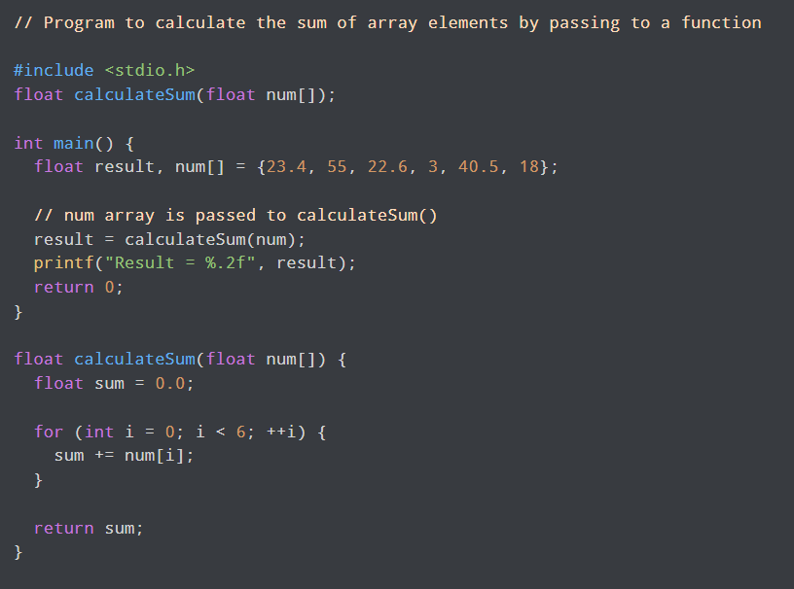
Passing Arrays to Functions
There are three ways to pass arrays to functions.
Second Way- The receiving parameters may be declared as an unsized array, as shown below
Syntax:-
return_type function(type arrayname[])

Slide 22
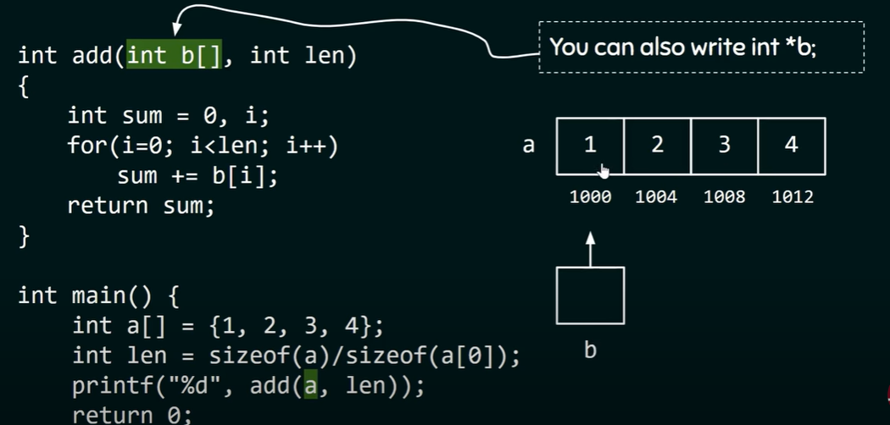
Passing Arrays to Functions
There are three ways to pass arrays to functions.
Third way-Formal parameters as a pointer
Syntax:-
return_type function(type *param)

Slide 23
Passing Arrays to Functions
There are three ways to pass arrays to functions.
Declared a with four elements with base address as 1000.
Len is calculated
In printf we are passing array a,
in this we are not passing complete array , we are just passing address of array

Slide 24
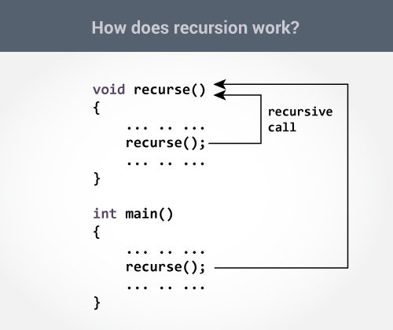
Recursion
A function that calls itself is known as a recursive function.
And, this technique is known as recursion.

Slide 25
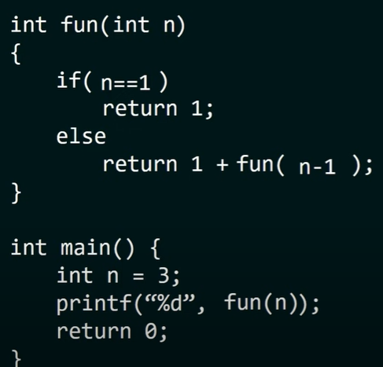
Program to Demonstrate Recursion

Slide 26
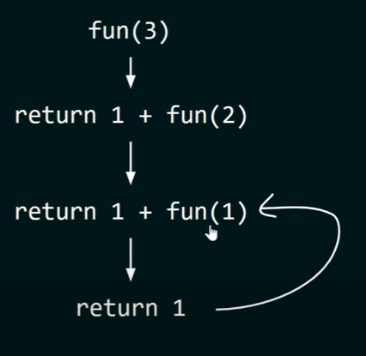
Understanding the Program
Execution starts from main function.
The value of n = 3, it calls fun function.(main function is caller of fun function)
In main function, if part becomes false, it becomes return 1 + fun(2), so from fun(3), we are calling fun(2). Similarly
in next iteration, it becomes return 1+fun(1), from fun(1), we are calling fun(2).
In next iteration, if codn is true and returning back 1 to fun(1) caller, return 1 + 1 = 2, 2 is returned to fun(2)
So it returns 3

Slide 27
Types of Recursion
There are four types of Recursion
1. Direct Recursion
2.Indirect Recursion
3. Tail Recursion
4.Non-Tail Recursion

Slide 28
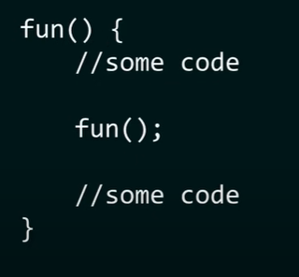
Direct Recursion
A function is called Direct recursion, if it calls the same function again.
Structure of Direct Recursion.
In the example, fun function calls, the fun function itself.

Slide 29
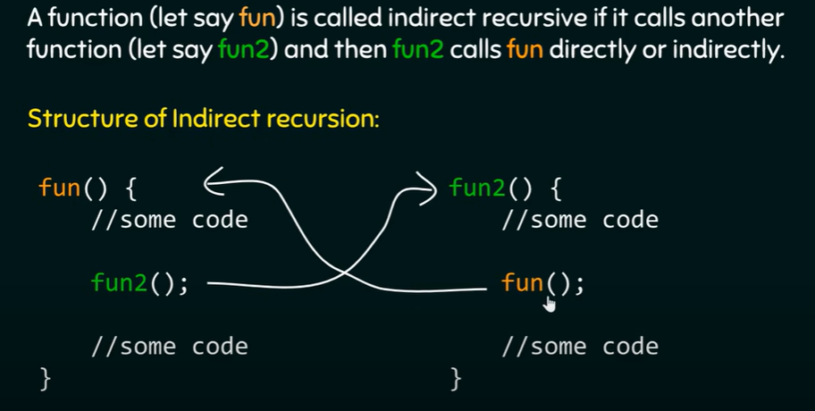
Indirect Recursion
Indirect recursion in C occurs when a function calls another function and if this function calls the first function again.
Such functions are also called indirect recursive functions.

Slide 30
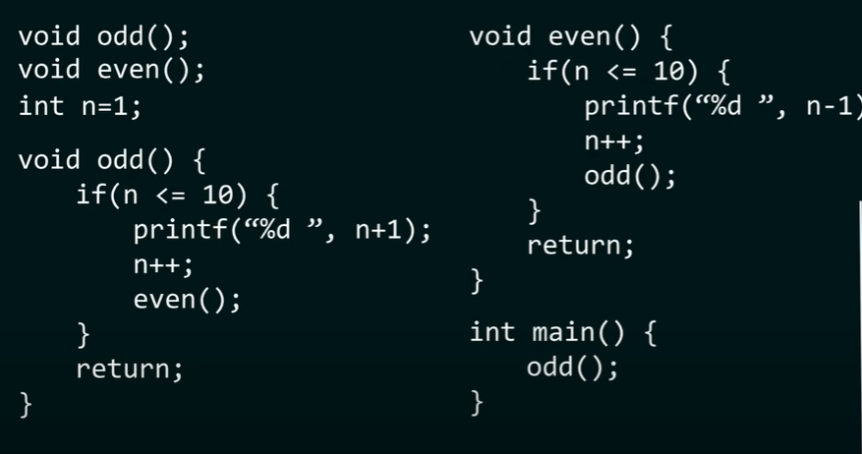
Example for Indirect Recursion
Write a C program, to print the numbers from 1 to 10 in such way that when it encounters odd number, increment it by 1 and when it encounters even number ,decrement by 1.

Slide 31
Example – Continued
In this C program we have function named odd() and even().
A variable n is assigned with a value 1
Now inside the odd() function, we have an if statement which states that if the value of n is less than or equals 10 add 1 to it and print. Then the value of n is incremented by 1(it becomes even), and the even() function is called.
Now inside the even() function, we again have an if statement which states that if the value of n is less than or equals 10 subtract 1 from it and print. Then the value of n is incremented by 1(it becomes odd, and the odd() function is called.
This indirect recursion goes on until the if condition inside both the functions becomes unsatisfied.
At last, we have the main() function inside, which we call the odd() function as the first number handle is 1, which is odd

Slide 32
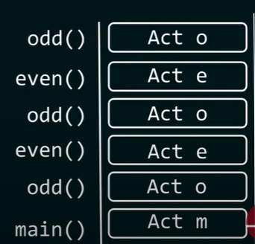
Example – Continued
Act means "Activation Record"
o means odd()
e means even()
m means main()
Output - 2 1 4 3 6 5 8 7 10 9

Slide 33
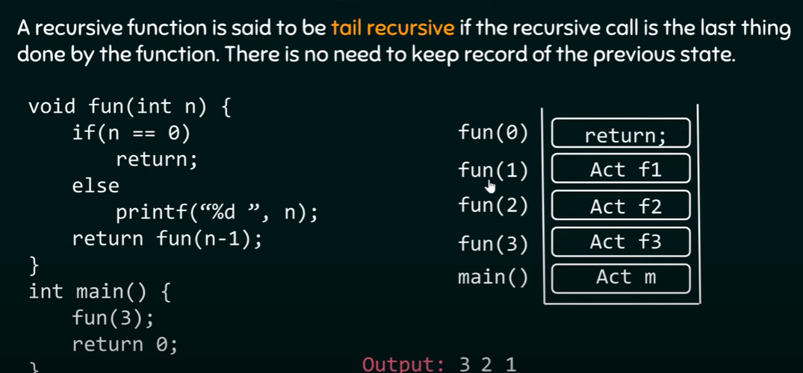
Tail –Recursion

Slide 34
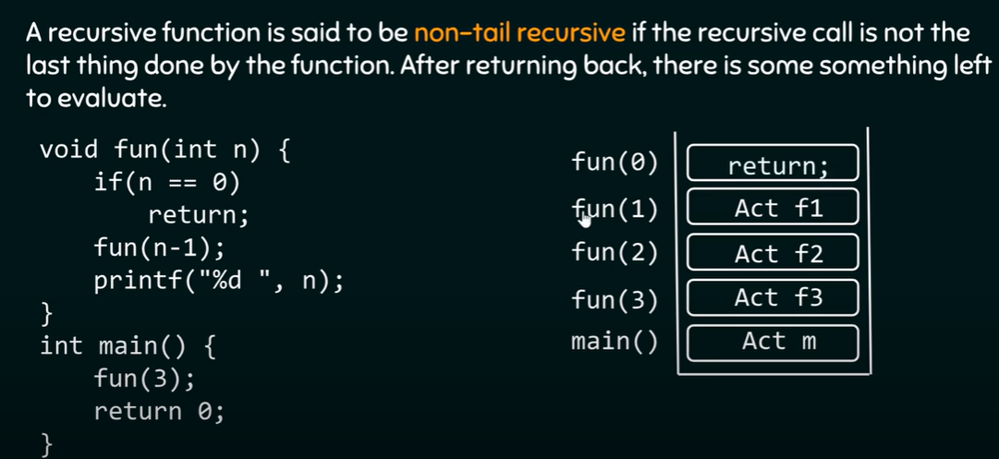
Non –Tail Recursion

Slide 35
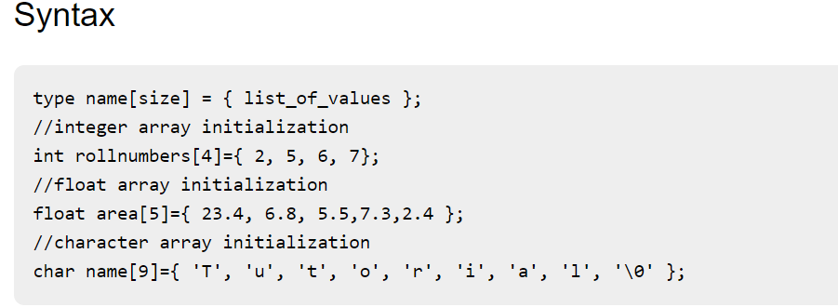
Compile time array initialization
In compile time initialization, user has to enter the details in the program itself.
Compile time initialization is same as variable initialization. The general form of initialization of array is as follows −

Slide 36
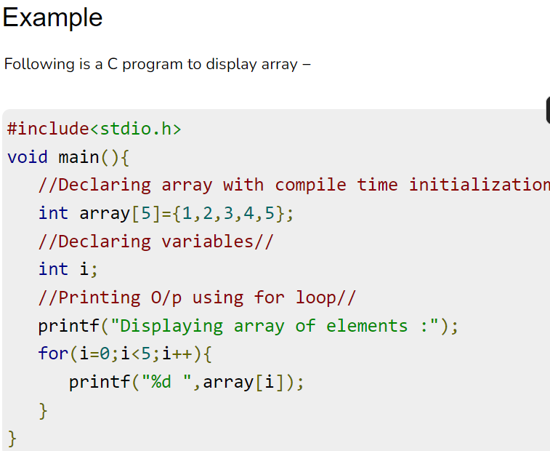
Compile Time Array Intilazation

Slide 37
Run time Array initialization
Using runtime initialization user can get a chance of accepting or entering different values during different runs of program.
It is also used for initializing large arrays or array with user specified values. An array can also be initialized at runtime using scanf() function.

Slide 38
Self-Study and Present
Assignment 1 - Tower of Hanoi – Application of Recursion
Assignment 2 – Difference between Recursion and Iteration

Slide 39


